Slide 1
Gaming Café
Database Management Systems

Slide 2
The Problem
There are lot of gaming Cafes, but not many have an efficient way to manage its Gamers using a single Software.

Slide 3
The Solution
A software application which helps in storing all the information of the gamers playing in the café.
The café manager can store all its gamers profile in the Database management system built into the Gaming café application.

Slide 4
The Application
The application for the gaming café helps the manager to store its gamers data like, name, email, time spent, password etc.
The application is connected to other client computers the gamer can login to his/her PC using the ‘gamer_tag’ and ‘password’ which is managed from the application.
The manager can keep track of the gamers time spent on the machine to charge accordingly.
The manager can also keep track of the games being played by individual gamers

Slide 5
The Database
The database has tables for Gamer, Games and Inventory.
The relations for the tables are:
Gamer play Games
Gamer has this Inventory

Slide 6
The Attributes
Gamer
Games
Inventory

Slide 7
ER Diagram

Slide 8
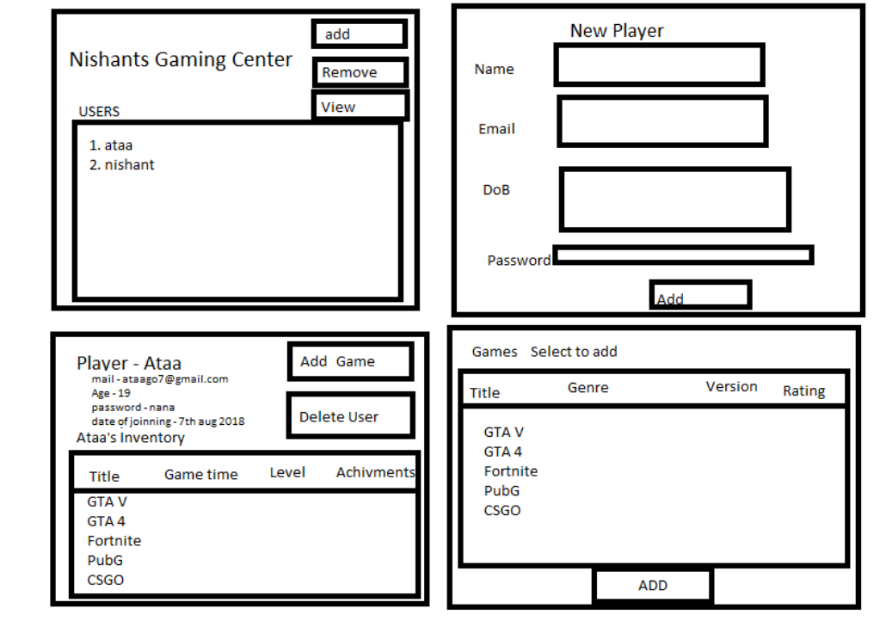
Layout Plan

Slide 9
Future Plans

Slide 10
Thank you
Mohammed Ataaur Rahaman
Nishant Ranjan

